Slide 1

Big Data Technologies Lecture 5
Lect. Dr. Adrian Spătaru

Slide 2
LAST TIME
MLLib:
Preprocessing
Transformation
Vector Assembler
String Indexer
One-Hot Encoder
Regression in Spark
Linear Regression
Decision Tree Regression
Regression Evaluator

Slide 3
AGENDA
Google Cloud Platform
Setting Up account
Google Data Proc
Virtual Machines
Redeeming 50$ coupons
Clusters
HDFS
Jupyter notebook and Spark
Cloud Storage
Bucket storage
HDFS storage

Slide 4
Google cloud platform
Big Data Technologies Lecture 5

Slide 5
GCP ACCOUNT SET-UP
Go to console.cloud.google.com
Login with your own Google account (not e-uvt)

Slide 6
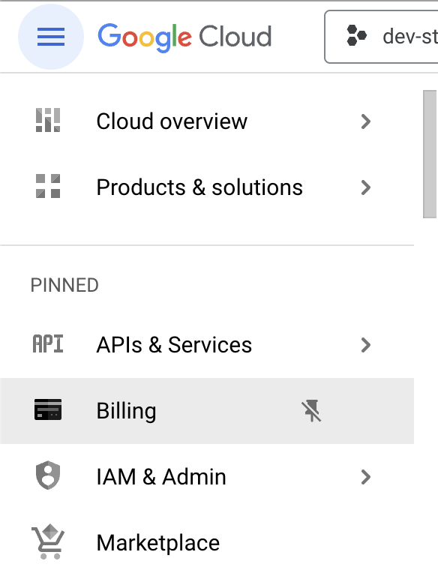
GCP BILLING ACCOUNT
Click the menu icon on the top left
Click Billing
Create a billing account
If you cannot create a billing account, contact the teacher

Slide 7
GCP COUPON REDEEM
Use Student Coupon Retrieval Link from the classroom Message.
Use e-uvt account to redeem ticket
You will receive a coupon code on email
Go to https://console.cloud.google.com/education
Make sure you are logged in with an account which can create billing accounts
Redeem credits.
A new billing account for education will be created

Slide 8
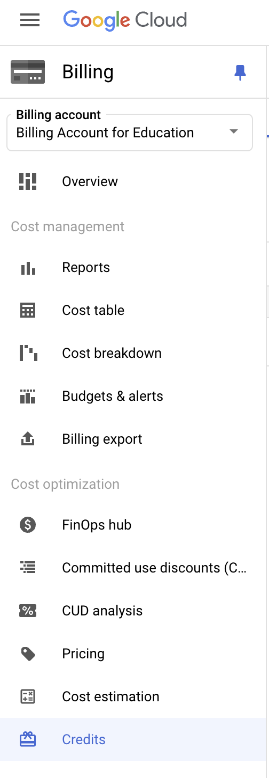
GCP CHECK CREDITS
Go to billing accounts
Click on the newly created billing account for education
There should be a link to Credits (scroll down)
You should have 50$, I have 100$ (cf. Figure)

Slide 9
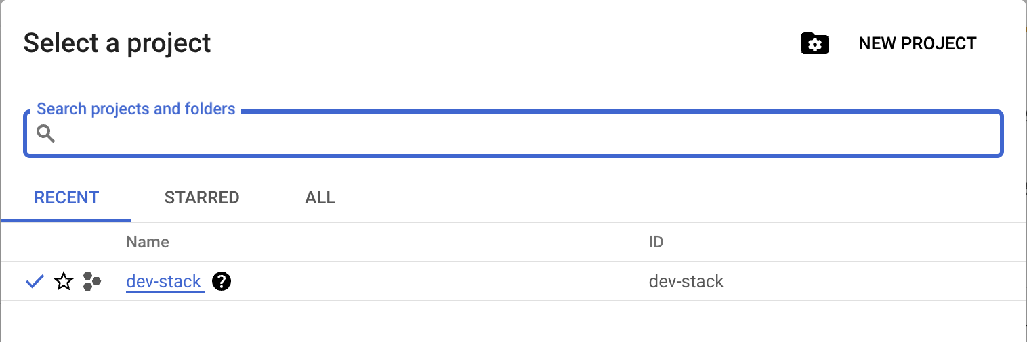
GCP DASHBOARD
Menu->Cloud Overview ->Dashboard
From top left click Projects -> New Project

Slide 10
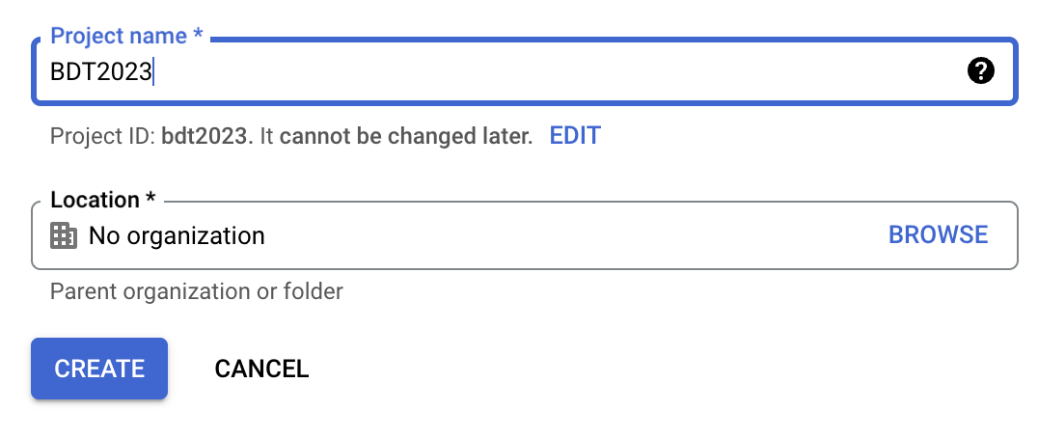
GCP DASHBOARD
Give project a name

Slide 11
Google DATAPROC
Big Data Technologies Lecture 5

Slide 12
GCP COMPUTE ENGINE
IaaS (Infrastructure as a Service)
Create Virtual Machines (VM)
Full control on the VM
Operating system
Memory and CPU
Disks
SSH connection
Public IP

Slide 13
GCP COMPUTE ENGINE
Menu -> Compute Engine
Enable this API
Wait for notification
Refresh

Slide 14
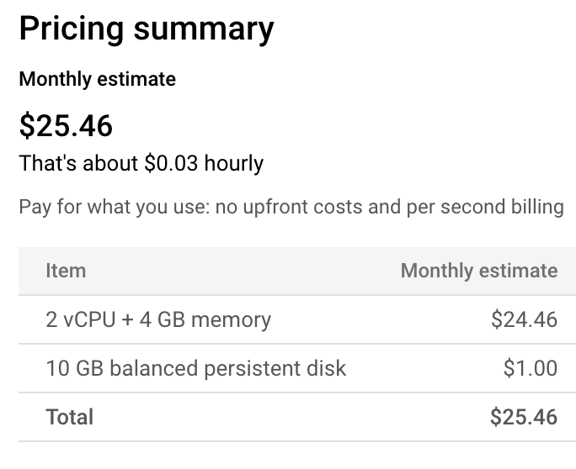
VM INSTANCES
Create Virtual Machine
Name
Region: region of the world (e.g. us-central, Europe-west)
Zone: Data Centre in selected region (a, b, c)
Series: CPU platform
Configuration: shared-core, standard, high-cpu, high-memory
Boot disk: for OS and software
Advanced options: Additional disks, security, management, etc..

Slide 15
GCP KUBERNETES ENGINE
IaaS (Infrastructure as a Service) on demand
Platform manages VM scaling (creation, deletion)
You pay based on demand
No control on the VM
Runs default image with Kubernetes node
You control container deployment
You control Kubernetes cluster properties
Use only if acquainted with Kubernetes

Slide 16
GCP DATAPROC (DATA PROCESSING)
IaaS (Infrastructure as a Service) for Clusters
Master-worker architecture
Supports Big Data Technologies Stacks:
Hadoop DFS, MapReduce, Spark

Slide 17
GCP DATAPROC
Use the search bar -> Data Proc
Enable this API
Wait for notification
Refresh

Slide 18
DataPROC CLUSTER
Using Compute Engine
You can also deploy on a Kubernetes Cluster

Slide 19
DataPROC CLUSTER PROPERTIES
Name
Type:
Single node (1 master, 0 workers) for testing
Standard (1 master, N workers)
High availability (3 masters, N workers)
Components:
Enable components Gateway
Select Jupyter Notebook

Slide 20
DataPROC CLUSTER PROPERTIES
Configure Nodes:
Basic VM settings similar to Compute Engine VMs
Master node configuration
Worker node configuration
Educational Account Quota:
Limited to 8 vCPUs, 500 GB SSD
You can choose n2-highmem-2 (2vCPU, 16GB memory) for both Master and Worker nodes
You can use standard persistent disk instead of Balanced persistent disk.
Customize
Disable Internal IP only
Wait for provisioning and configuration of VMs

Slide 21
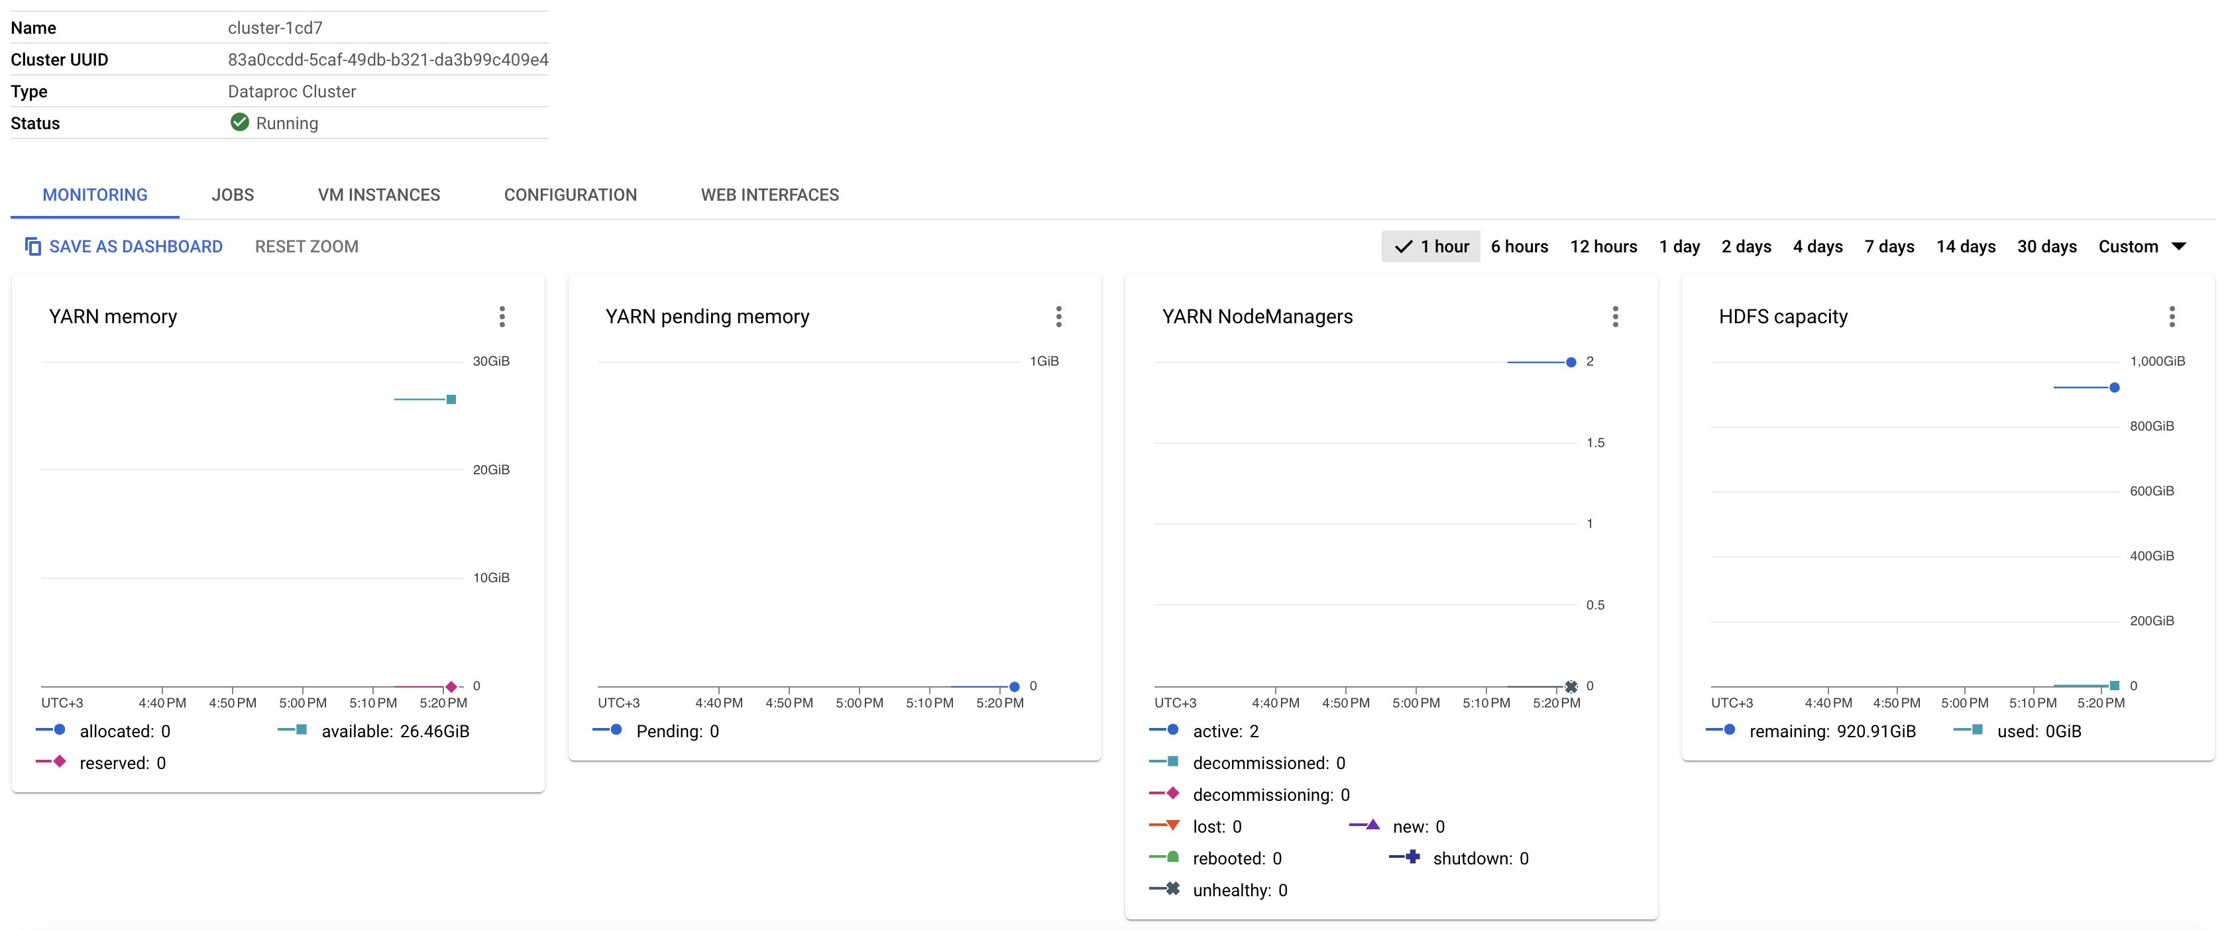
CLUSTER MONITORING

Slide 22
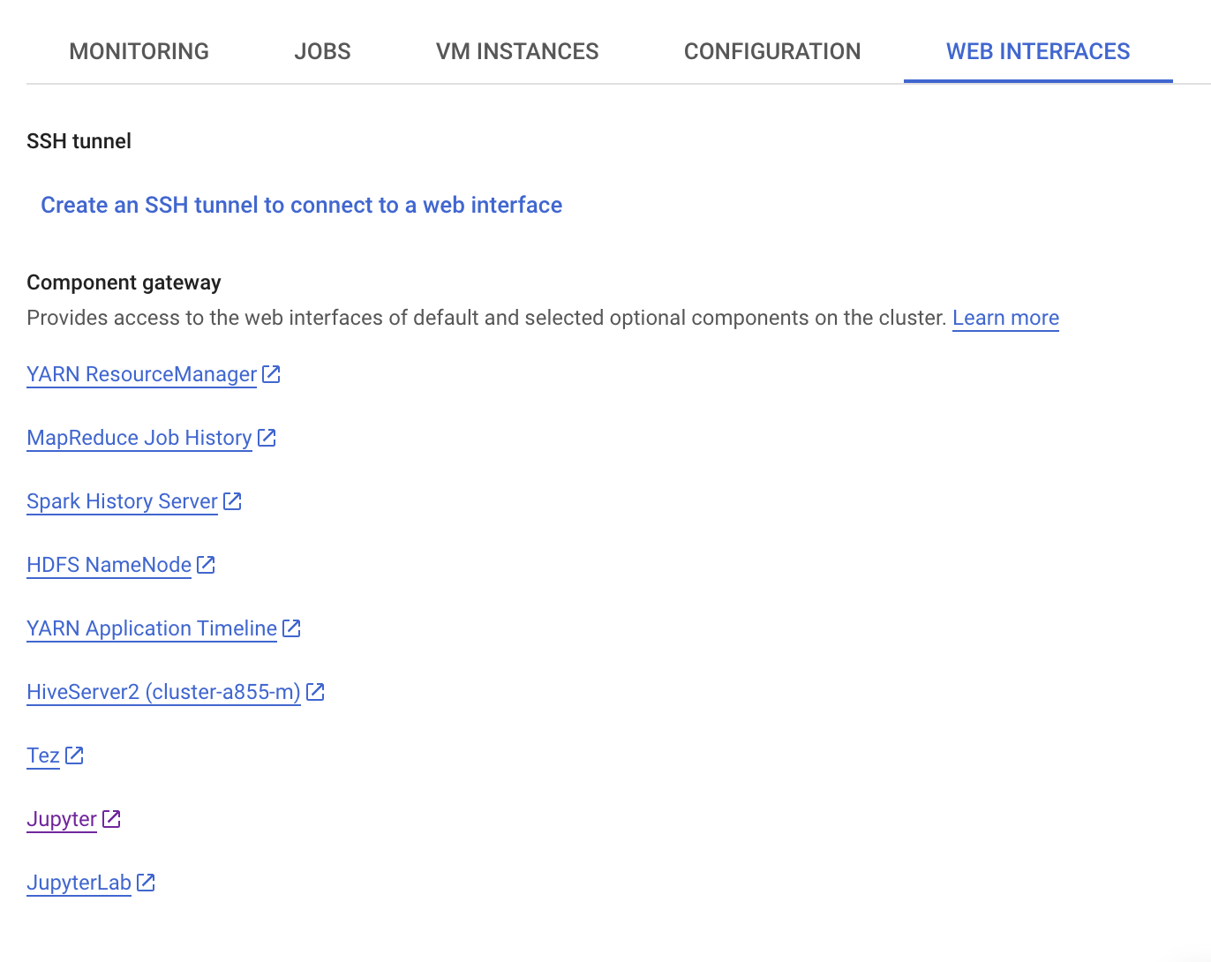
CLUSTER WEB INTERFACES
Requires enabling when creating the cluster
Click on JupyterLab

Slide 23
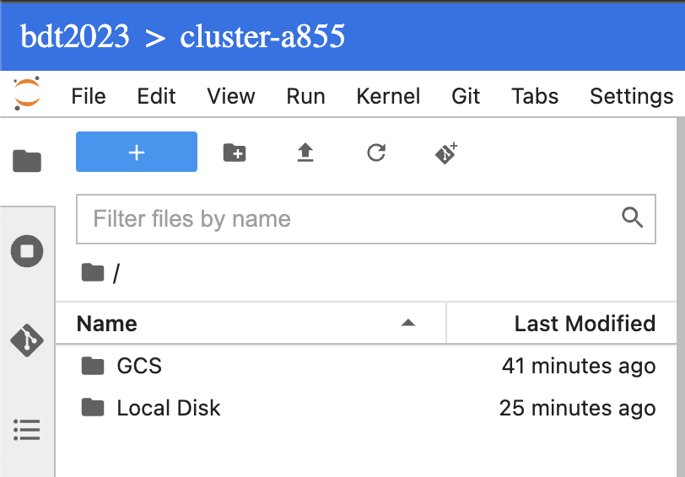
CLUSTER JUPYTER STORAGE
GCS:
Google Cloud Storage bucket
Local Disk:
Temporary space

Slide 24
Connecting SPARK
from pyspark.sql import SparkSession
spark = SparkSession.builder \
.appName("MyApp") \
.master("yarn") \
.config("spark.executor.memory", "6g") \
.config("spark.executor.cores", "2") \
.config("spark.executor.instances", "2") \
.getOrCreate()
print(spark)

Slide 25
CLOUD STORAGE
Big Data Technologies Lecture 5

Slide 26
GCP Cloud Storage
Storage Bucket:
Manage access to bucket
Pay only for the used space
DataProc Buckets:
Created automatically for a DataProc cluster
Reused when a new one is created
One for master node
One for worker nodes

Slide 27
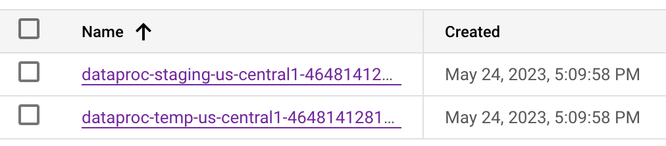
DATAPROC BUCKETS
Staging Bucket:
DataProc meta-info
notebooks/jupyter → GCS folder in Jupyter interface
temp Bucket:
Used for job history

Slide 28
GCP Cloud Storage
Create Bucket
Name
Location (Multi-region, Dual-region, One region)
Storage class (Standard, Nearline, Coldline, Archive)
Access control (Uniform, fine-grained)
Protection (versioning, retention policy)

Slide 29
FINAL REMARKS
Don’t forget to stop (delete) your cluster when you’re not using it.
Download your jupyter notebook before deleting the cluster
Test algorithms locally → Deploy them on cluster

Slide 30
Storage BUCKET VS HADOOP
Big Data Technologies Lecture 5

Slide 31
Spark READS data from both sources
Google Storage:
df = spark.read.json("gs://bdt-bucket-2024/google_cluster_data/instance-usage")
Hadoop Distributed File System:
df = spark.read.json("hdfs:///user/bdt/google")

Slide 32
Storing Data in hdfs
Google Storage:
Create a bucket
Store your content
Jupyter
Open a terminal
Use gsutil to download the data from the bucket
gsutil cp -r gs://bucket/folder1/folder2 ./data
Store the data in HDFS
hdfs dfs –mkdir /user/name (create folder for user)
hdfs dfs –mkdir /user/name/data (create data folder for user)
hdfs dfs –put ./data /user/name/data (store data in HDFS)

Slide 33
CAUTION
Data in HDFS is stored on the local disk of the machines.
If you delete your cluster the data will disappear.
You will need to load back your data in a new cluster.

Slide 34
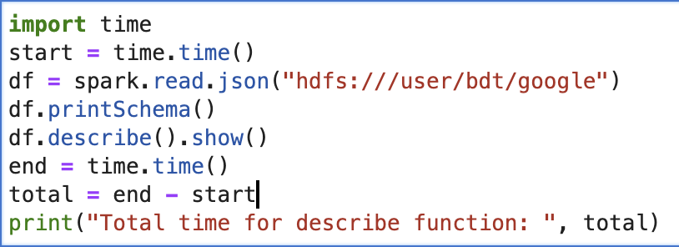
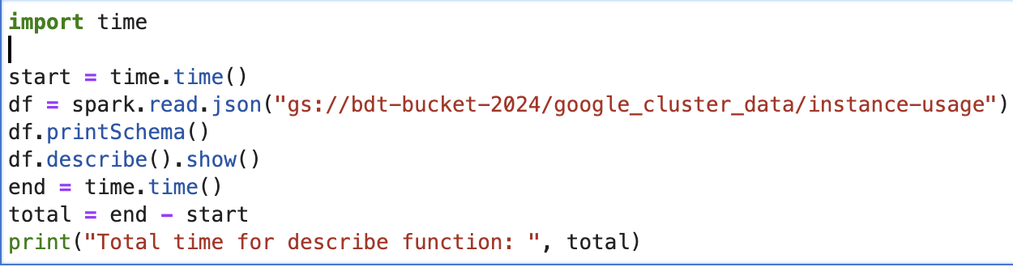
Why use Hadoop then?
HDFS
Google Storage
79.93
112.62

Slide 35
Sources
https://codelabs.developers.google.com/codelabs/spark-jupyter-dataproc#0
https://github.com/GoogleCloudDataproc/cloud-dataproc/blob/master/notebooks/python/2.1.%20Google%20Cloud%20Storage%20(CSV)%20%26%20Spark%20DataFrames%20-%20Python.ipynb

Slide 36
PROJECT REQUIREMENTS
Big Data Technologies Lecture 5

Slide 37
REQUIREMENTS
Jupyter notebook
Document
Introduction, Motivation
Related Work (articles)
Experiment methodology
Setup
Results
Conclusion

Slide 38
REQUIREMENTS
Methodology
Data description
Data pre-processing
Data transformation
Algorithms

Slide 39
REQUIREMENTS
Setup
Local (local docker image + local storage)
Cloud DataProc (cluster + bucket storage)
Configuration (both local and Cloud)
CPU, memory
Number of nodes (cloud)

Slide 40
REQUIREMENTS
Results
Algorithm accuracy
Algorithm run time
Discussion
How does the accuracy compare? Is it in line with other papers?
Is there an improvement in run time when using Cloud resources? WHY?
Conclusion

